Slide 1
Autonomous Greenhouse System
Presented by: Jaxson Billings, Jared Hooker, Grant Hooper, Noah Jones, and Bryan Rhoton

Slide 2
Problem and Proposed Solution
While there are many benefits of a greenhouse, one problem that arises is the need for human assistance to maintain plant growth and overall health of the greenhouse.
The Agricultural Department at Tennessee Tech provided a greenhouse where our team could implement the designs and physical hardware.
One issue our team observed was the lack of wall outlets within the greenhouse. This would mean that most devices would require wireless data transmission and wireless power sources.
Our proposed solution was to provide the greenhouse with the necessary tools and equipment to measure environmental factors without the presence of a human.

Slide 3
BLE Communication Architecture
Bluetooth Low Energy (BLE) Overview:
Peripheral Devices: Arduinos take in data from each of the subsystems, which includes CO2, NO2, Lighting, Temperature/Humidity, Water Level, and NPK sensors connected to Arduino Nano 33 IoT's equipped with BLE capabilities.
Central Arduino: Acts as the central hub, responsible for scanning, connecting to peripherals, data collection and sending to the PLC.
PLC Integration: Interfaces between the central Arduino and the HMI, facilitating communication with higher-level systems. It is connected to the central Arduino via TTL-RS232 converter.
Communication Flow:
Peripheral Operation: Sensors periodically collect data through various communication protocols and transmit it via BLE notifications.
Central Arduino: Scans for nearby peripherals, establishes connections, and retrieves data from characteristic attributes.
PLC Integration: Processes data received from the central Arduino and relays it to the HMI for visualization and control.
Advantages of BLE:
Efficiency: Enables seamless data exchange between subsystems, promoting real-time monitoring and control.
Scalability: Supports the integration of additional sensors or actuators as the greenhouse system expands.
Reliability: Provides stable and robust communication, essential for uninterrupted greenhouse operation.

Slide 4

BLE Communication Protocol
Peripheral Devices:
Equipped with BLE modules, sensors collect environmental data and advertise their services via BLE. For example, the NO2 sensor communicates via SPI, DHT20 (Temperature/Humidity Sensor) through I2C, and so on.
Actuators, such as the lighting subsystem, receive control signals wirelessly for automated operation. These include information that can change how many hours the lighting system should be on/off.
For a peripheral device to properly transmit the data it has collected it must set a BLEService variable with a unique ServiceUUID within. It then must set a BLECharacteristic variable set with a CharacteristicUUID, the type of peripheral it will be (e.g. BLERead, BLENotify, or BLEWrite), and the size of the data. Next, it must set a local name to advertise, it must set the advertised ServiceUUID, it must have the characteristic variable added to the service variable, you must then add the service variable to the BLE class, and finally advertise it all. To add a value to the characteristic it must have the data for the sensor saved in a variable and use writeValue() function to add it to the specific characteristic variable that is desired.
Central Arduino:
Utilizes Arduino BLE libraries to scan for nearby peripherals and establish connections.
Reads characteristic values from discovered services, collects data, and forwards it to the PLC for further processing.
The peripheral devices have unique Service UUID's so that the Central Arduino will be able to tell the peripheral devices apart. While the Characteristic UUID's stay the same because it is within the Service UUID and will not interfere with the other peripheral devices.

Slide 5
BLE Communication Protocol
Central Arduino:
For the central Arduino to correctly read in the data from each peripheral Arduino the following must be done. An array with the peripheral device's information, including the address and unique ServiceUUID, of each of the peripheral devices. Next, the device will need to use the BLE.scan() function and specify the addresses that are desired. The device information will need to circled through as data is taken in to keep data from being duplicated. Next, the central device will look for available devices and stop to investigate further if one of the specified addresses is hit. If the peripheral address is the same as the target address, the address, local name, and UUID will be printed via serial. The device will then dive deeper into the attributes, characteristic UUID, and finally the characteristic's values. Once this has been collected, it will be sent to the PLC via ASCII Hex and the next device's information will be searched for. Once all addresses have been searched and successfully found, the device will stop searching for a period before it starts searching again.
Future Directions:
Continued optimization of BLE communication protocols for enhanced performance and reliability.
Integration of advanced BLE features for increased functionality and interoperability with other IoT devices.
Given that BLE is a newer technology, it is inevitable that updates and upgrades to this process will happen.

Slide 6
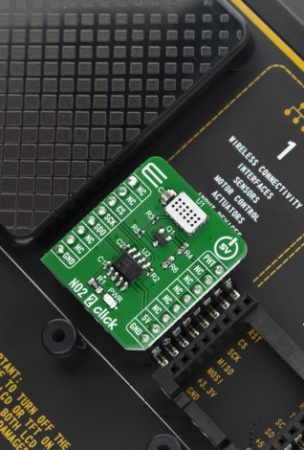
NO₂ Subsystem
Sensor Selection:
MIKROE 3700: Selected for its compact metal oxide (MOS) sensor, MiCS-2714, designed to detect nitrogen dioxide (NO2) and hydrogen (H2).
Impedance-Based Detection: Reacts to the presence of NO2 and H2, with impedance changes enabling voltage measurement in a voltage divider configuration.
Interface:
SPI Communication: Utilized the SPI (Serial Peripheral Interface) interface for communication between the sensor and the Arduino Nano 33 IoT board.
Voltage Sampling: Voltage output from the sensor's A/D converter (ADC) sampled directly over the I2C interface for accurate data retrieval.
Library Utilization:
Arduino SPI Library: Integrated to facilitate communication between the sensor and the Arduino Nano 33 IoT board via the SPI interface.
Functionality: Enabled seamless data transfer and access to sensor readings, enhancing the usability of the NO2 sensor within the greenhouse system.

Slide 7
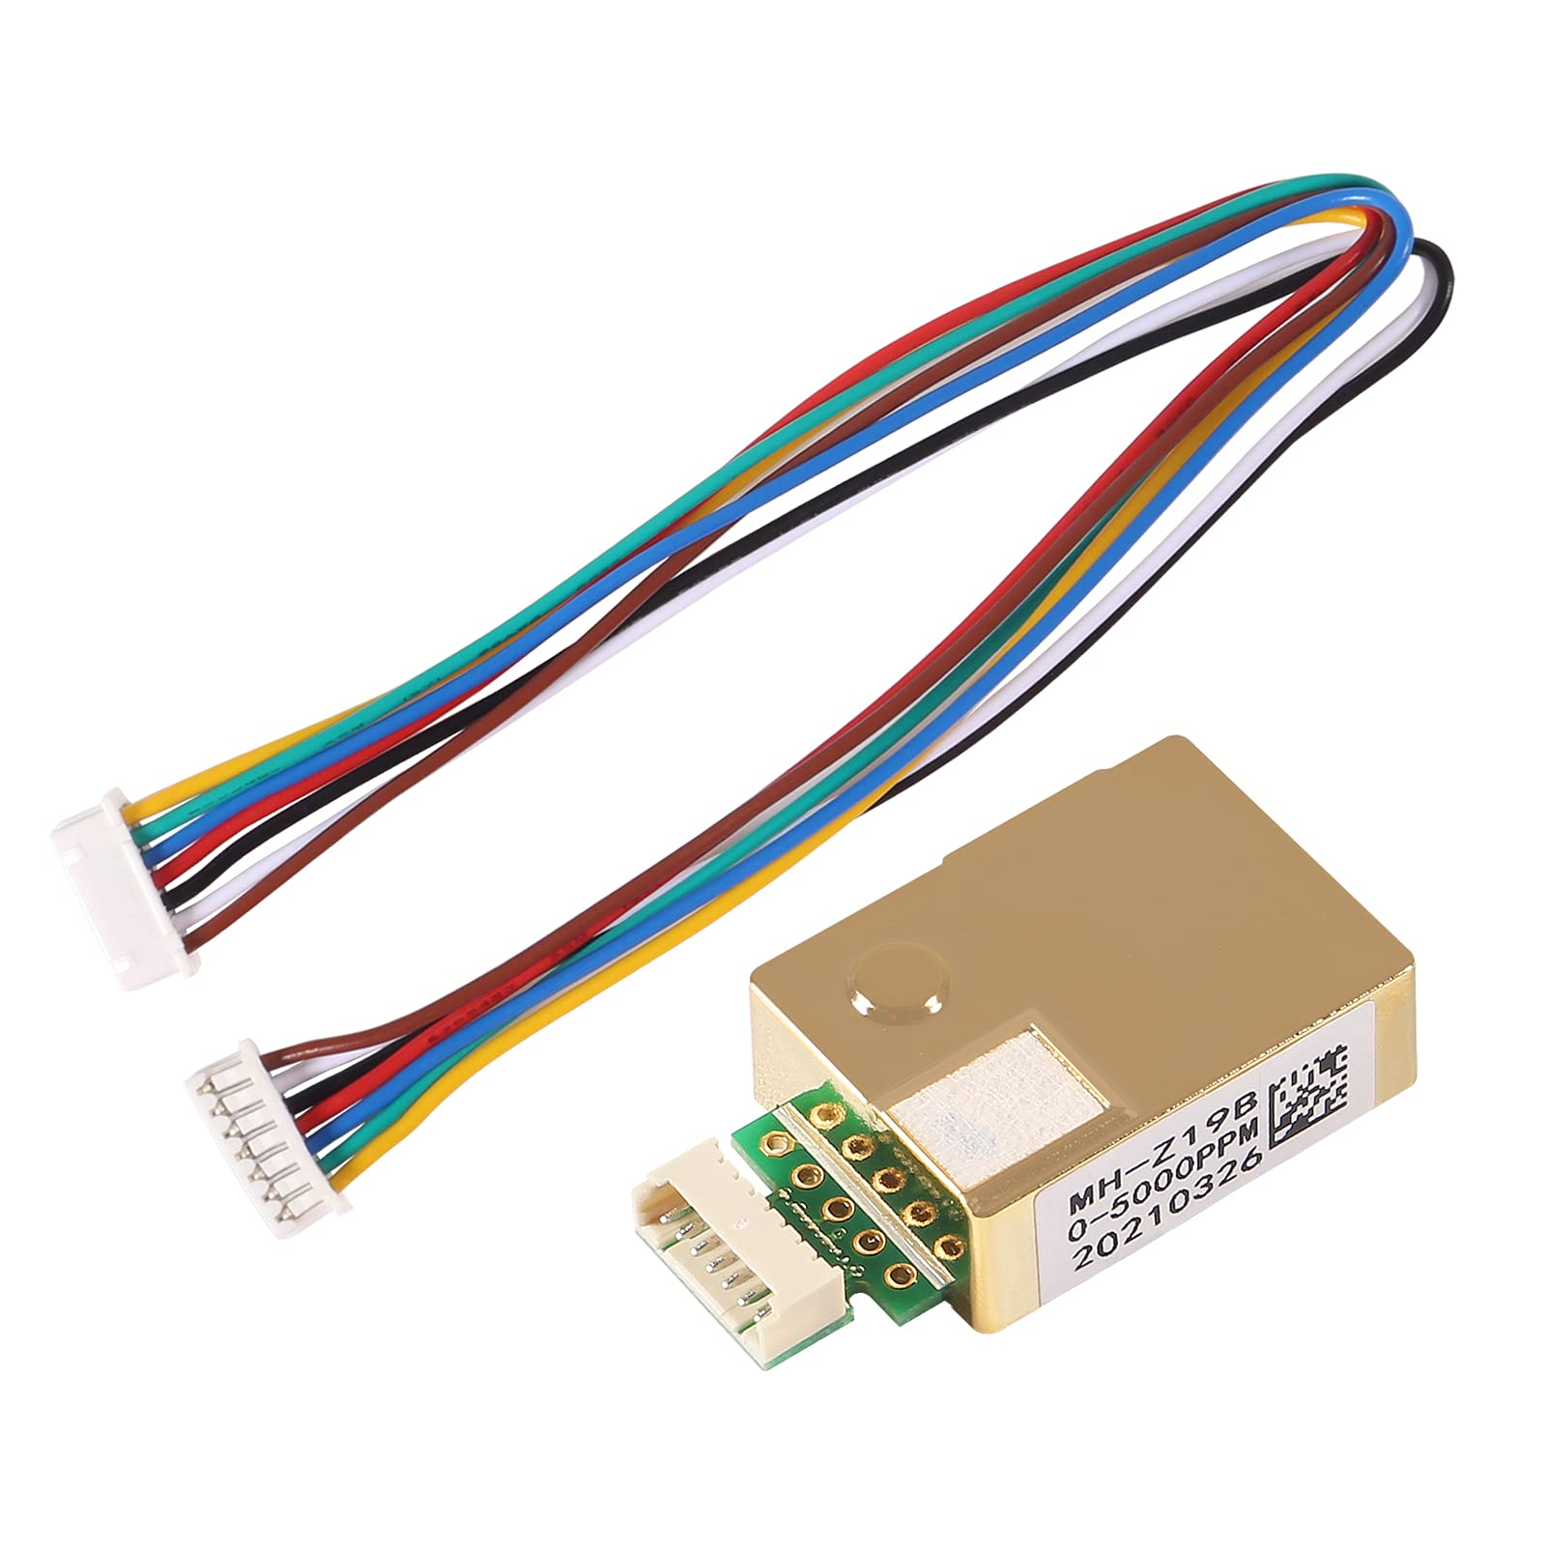
CO₂ Subsystem
Sensor Selection:
MH-Z19B: Chosen for its serial communication interface (UART), making it compatible with the Arduino Nano 33 IoT board.
Interface: Connected directly to the Arduino Nano 33 IoT board via UART pins, utilizing 5V supply voltage and 3.3V logic level without the need for a level shifter.
Library Utilization:
MHZCO2 Library: Integrated to facilitate measurement functions and streamline data collection processes.
Functionality: Simplified the implementation of CO2 measurement capabilities, providing access to essential functions for gathering accurate CO2 concentration data.
Power Supply:
Voltage Compatibility: Operated within the specified voltage range of 5V, ensuring optimal performance and reliability.
UART Level: Utilized UART communication with a 3.3V level, eliminating the need for additional level shifters and simplifying the wiring setup.

Slide 8
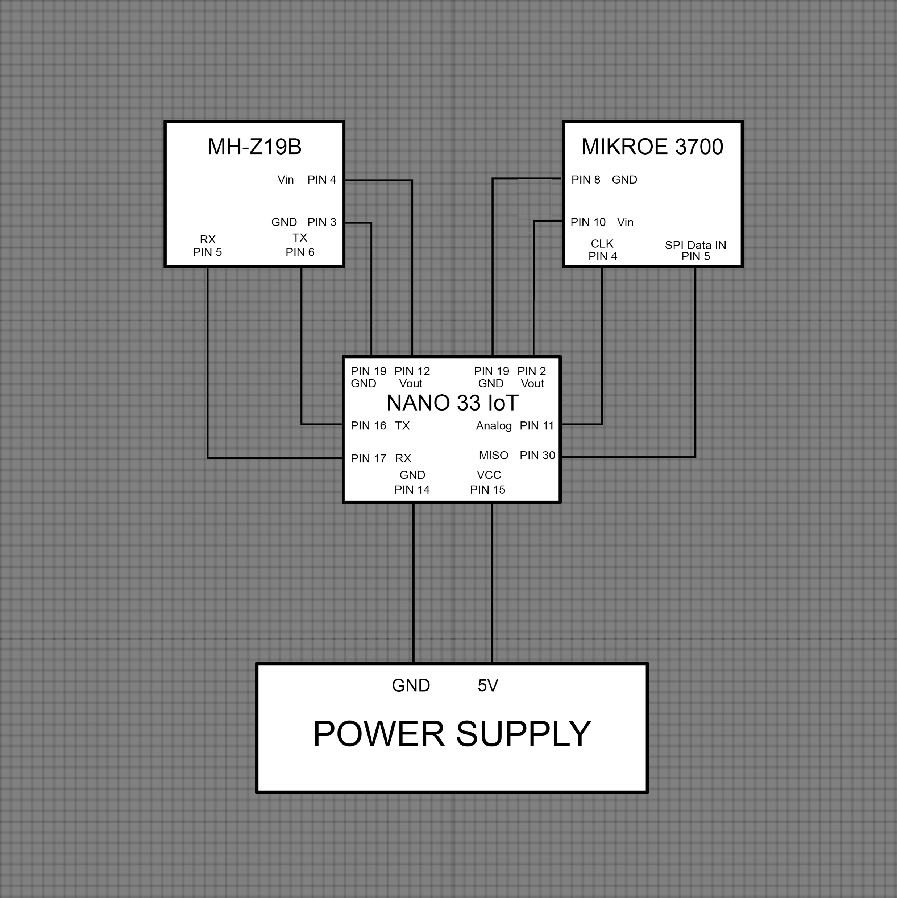
CO2 and NO2 Schematic
CO2 and NO2 Description:
The MH-Z19B CO2 sensor and the MIKROE 3700 NO2 sensor are both connected to the same Arduino Nano 33 IoT to make sending both sets of air quality data to the PLC easier and more compact.
The CO2 sensor communicates with the Arduino via the Arduino’s serial rx and tx pins while the NO2 sensor communicates with the Arduino via 12-bit ADC through the Arduino’s Analog and MISO pins.
The system is powered by a battery pack power supply which supplies the required voltage to the Arduino that in turn supplies 3.3V to the NO2 sensor and 5V to the CO2 sensor via the Arduino’s 5V and 3.3V output pins respectively.

Slide 9
Temperature and Humidity Sensor Setup
Sensor Selection:
Adafruit DHT20: Chosen for its compatibility with our system's voltage range (3.3-5V) and accurate temperature and humidity sensing capabilities.
Interface: Connected to the Arduino Nano 33 IoT via digital pins, set to output high, for power (3.3V), ground, RX (Pin 17), and TX (Pin 16) to enable communication via I2C protocol.
Library Utilization:
DFRobot_DHT20 Library: Employed for accessing functions essential for gathering temperature and humidity data from the DHT20 sensor.
Functionality: Enabled seamless integration of the sensor into our system, ensuring accurate and reliable data collection.
Power Management:
SleepyDog Library: Integrated to implement power-saving measures for the Arduino Nano 33 IoT.
Sleep Mode: Utilized to put the Arduino Nano 33 IoT to sleep for 5 minutes between data collection intervals, optimizing power consumption without compromising functionality.

Slide 10
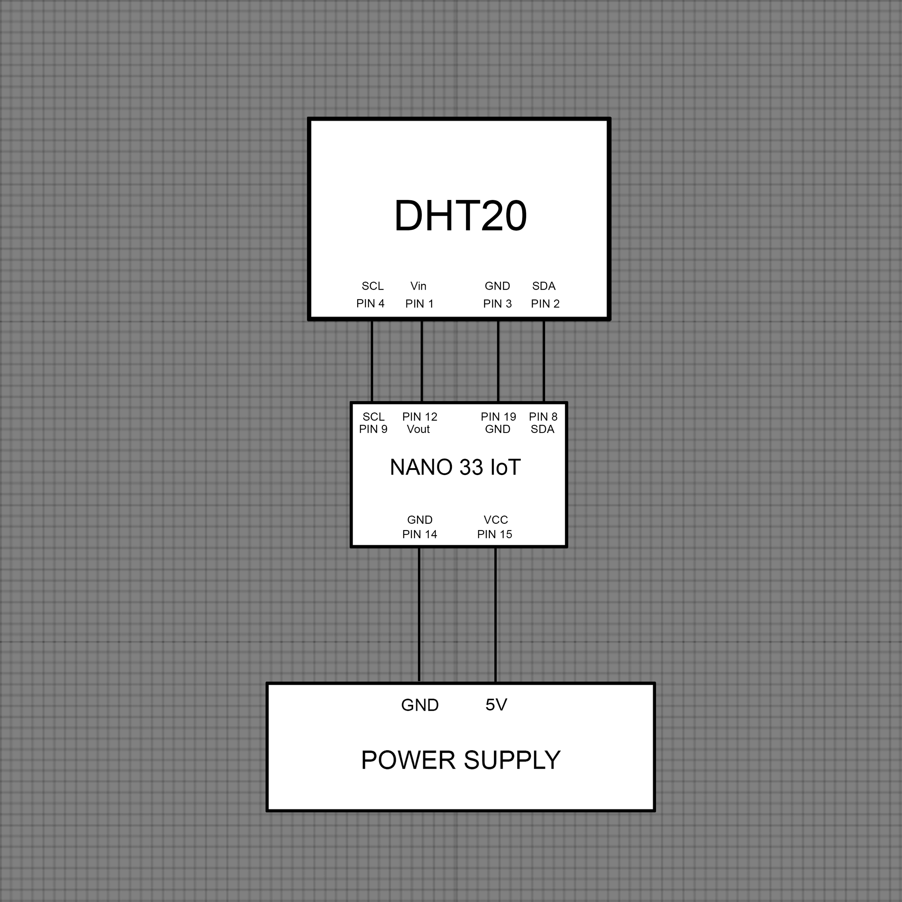
Temperature and Humidity Schematic
Temp and Humidity Description:
The DHT20 temperature and humidity sensor is connected to an Arduino Nano 33 IoT to send temperature and humidity data to the PLC and to be able to receive requests and commands for further data from the PLC.
The sensor and the Arduino are also connected to a battery pack power supply that supplies the voltage to power the Arduino which in turn powers the DHT20 sensor via the Arduino’s 3.3V output port.

Slide 11
Temperature & Humidity Experimentation
Experimentation was observed in a room with a temperature of 20°C (68°F).
Temperature and humidity values were gathered 18 separate times to ensure consistent accuracy.
The average temperature read from the DHT-20 was 19.78°C, resulting in a 1.1% error.
The average humidity in the room was 40.93%. A humidity level of 30-50% is common for indoor spaces.
Problems encountered:
Temperature readings initially were always 150°C. Minor soldering issues were believed to cause this error, so we resoldered the sensor connections and we were then provided with correct values.

Slide 12

Lighting Subsystem
Capabilities:
The lighting system can power a series of led grow lights to assist in and accelerate the growth of a variety of plants.
The system also contains an Arduino Nano 33 IoT to control the times that the lights are powered off and on.
Implementation:
The system is powered from a 120V wall outlet that is routed through a 15A breaker and a 5V relay module for added protection against current surges and control of the light cycles.
Issues:
One issue our team faced in designing the lighting system was being able to find a power relay that would take a low enough input voltage while being able to handle a high enough output current at a low enough price to fit our budget and constraints.
Fixes:
To fix the issue of the power relay we were able to find a relay module that would fit all our constraints and was cheap enough to fit in our budget.

Slide 13
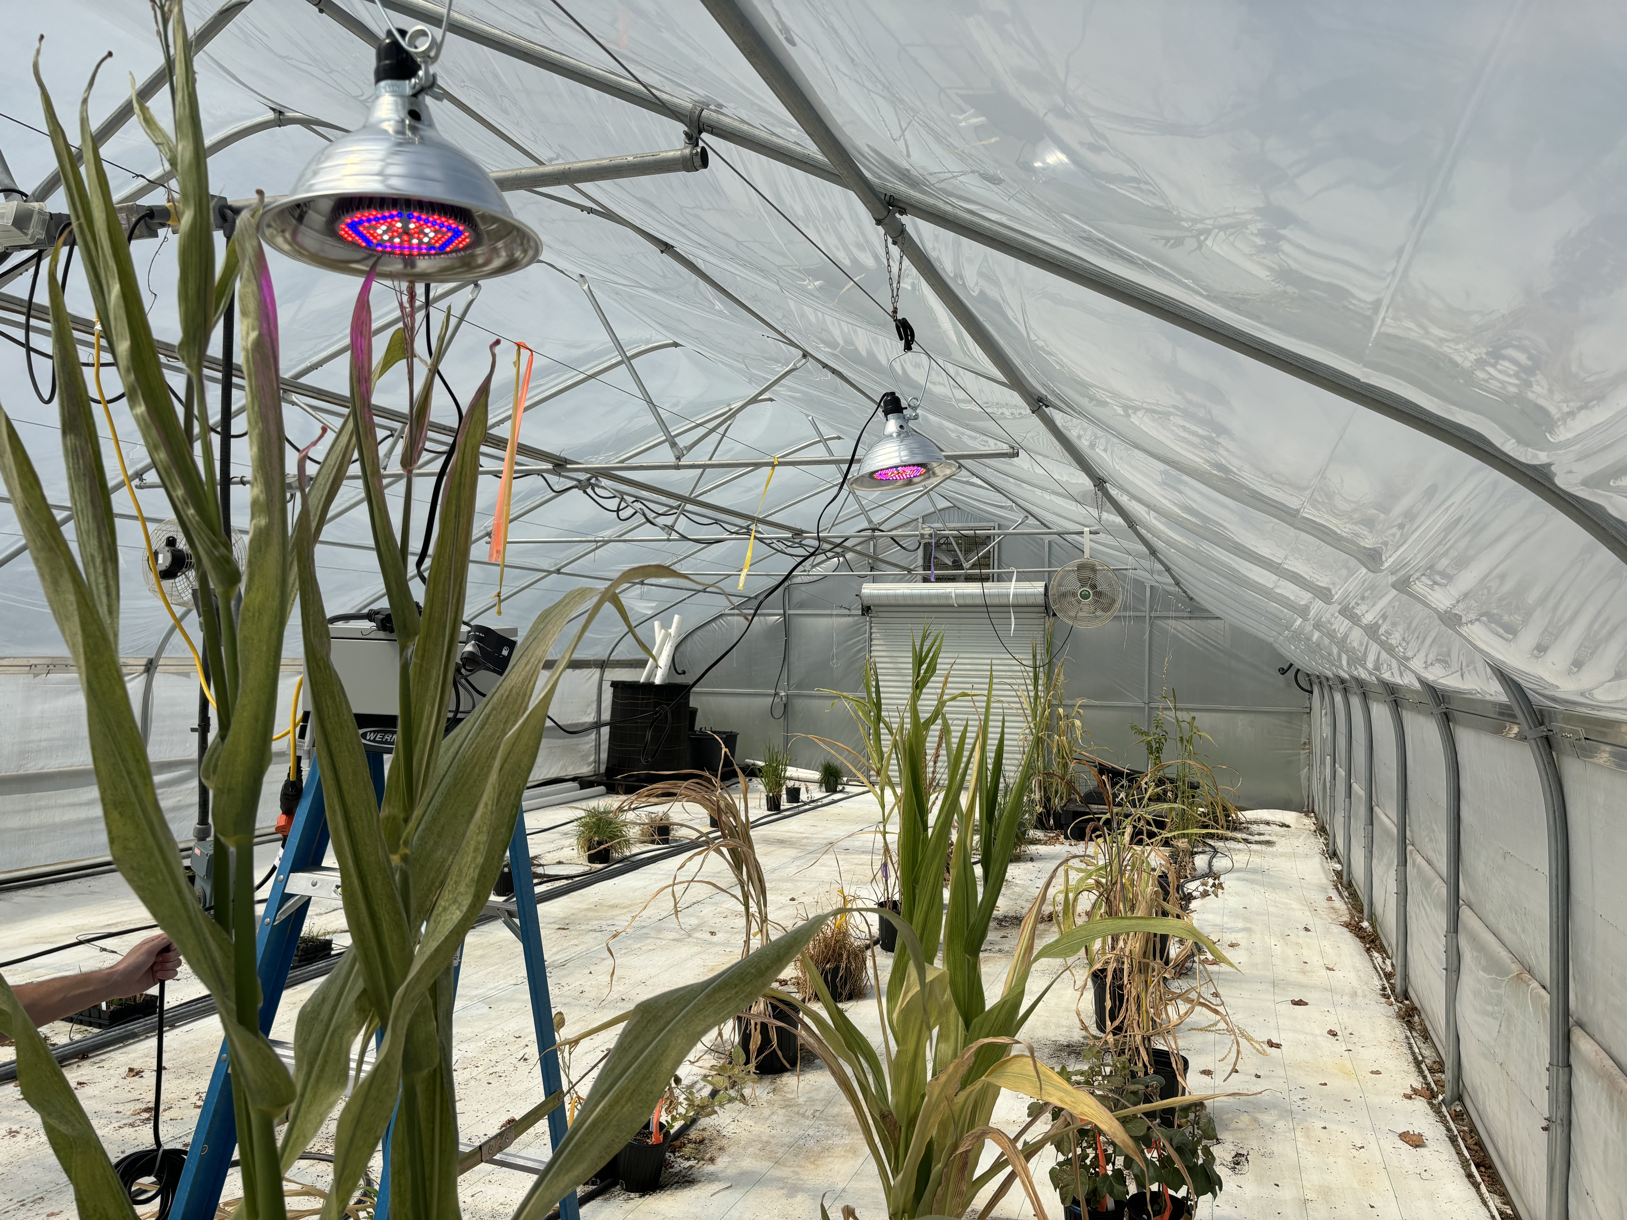
Lighting Subsystem
Experimentation:
To test the lighting system, we plugged the lights into a wall outlet and ensured that the relay was able to power all lights and that the Arduino was able to cycle the lights on and off.
https://youtube.com/shorts/7rGN4WbYHF8?feature=share

Slide 14
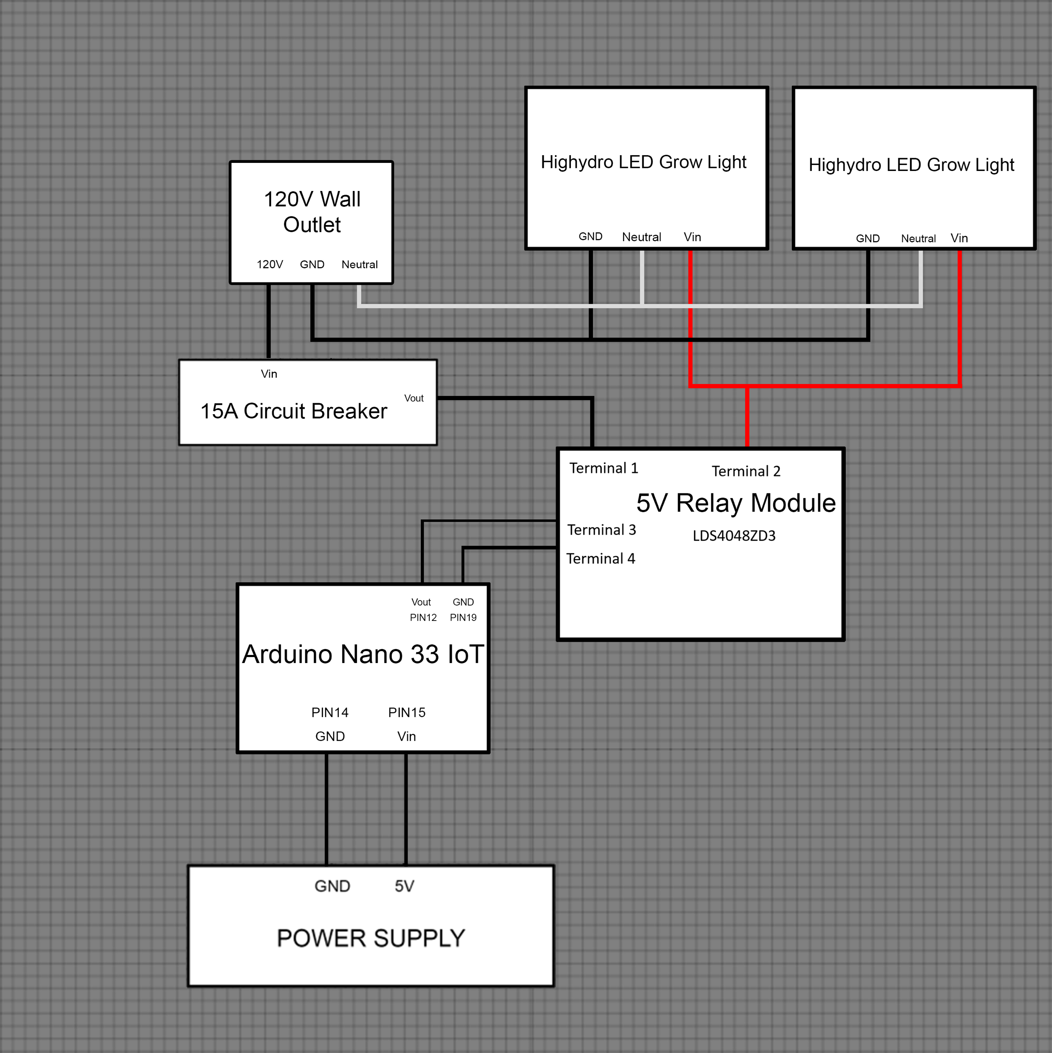
Lighting Schematic
Lighting Description:
As seen in the schematic provided, the lighting system contains a 5V relay module connected to an Arduino Nano 33 IoT to control the times that the lights are powered on and off.
The relay module is routed through a 15A circuit breaker to a 120V wall outlet to account for possible power surges and reduce the risk of damage to the system by said surges.
The outlet and relay are then connected to a series of led grow lights that are powered via the relay module and grounded with the ground and neutral pins of the wall outlet.

Slide 15
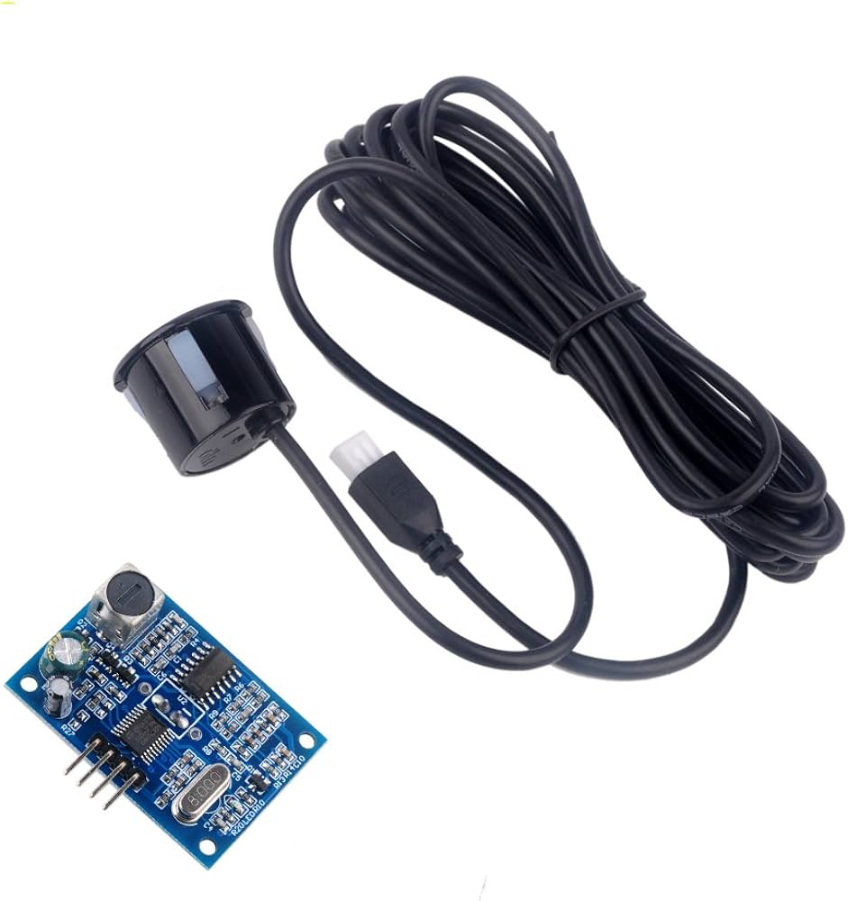
Water Level Subsystem
Sensor Selection:
JSN-SR04T Ultrasonic Sensor: Utilized for measuring the distance between the sensor and the surface of the water in a 55-gallon barrel, which is the greenhouse reservoir.
Interface: Connected to the Arduino Nano 33 IoT board with the Trigger Pin (Digital Pin 2) and Echo Pin (Digital Pin 3) for distance measurement.
Measurement Process:
The sensor sits on two dowels suspended on the top of the reservoir.
Triggering: Initiates the ultrasonic sensor by sending a short pulse through the Trigger Pin.
Sound Travel Time: Calculates the duration for the sound wave to travel from the sensor to the surface and back.
Distance Calculation: Utilizes the sound travel time to compute the distance between the sensor and the water surface in centimeters.
Data Output:
Serial Communication: Sends the measured distance data over the serial communication interface for monitoring and analysis.
Output Format: Distance values in centimeters are printed to the serial monitor for real-time observation.
Once the distance has been output to the Arduino, we do a quick check to see if the water level is below ¼ the total height of the barrel, and if it is we send an alert to the PLC.

Slide 16
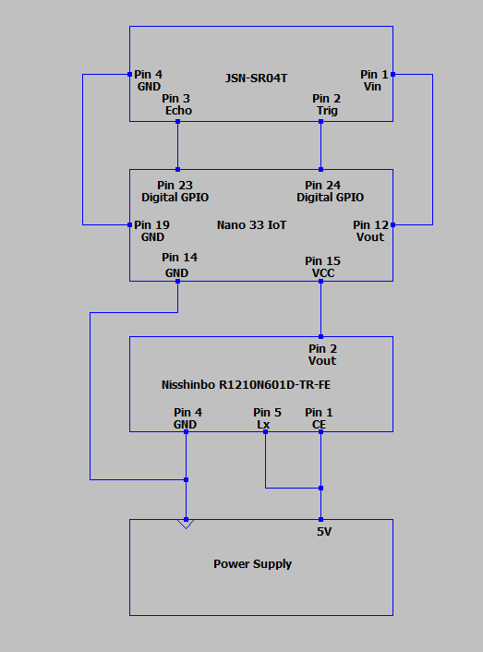
Water Level Subsystem
The sensor, or the JSN-SR04T, has its for pins connected to the Arduino Nano 33 IoT. These connections are power in(providing 5V), ground, echo and trig. The trig pin tells the sensor to send an ultrasonic wave while the echo pin goes high when the echo of said wave returns to the sensor.
The Arduino Nano 33 IoT provides the JSN-SR04T with 5 volts while also communicating with it which will use code to mathematically decipher the distance being measured. It will be connected to the Nisshinbo R1210N601D-TR-FE to receive its own power of 5V.
The Nisshinbo R1210N601D-TR-FE regulated the power outputted by the battery pack so that voltage is kept consistent through the system and kept at 5V.

Slide 17
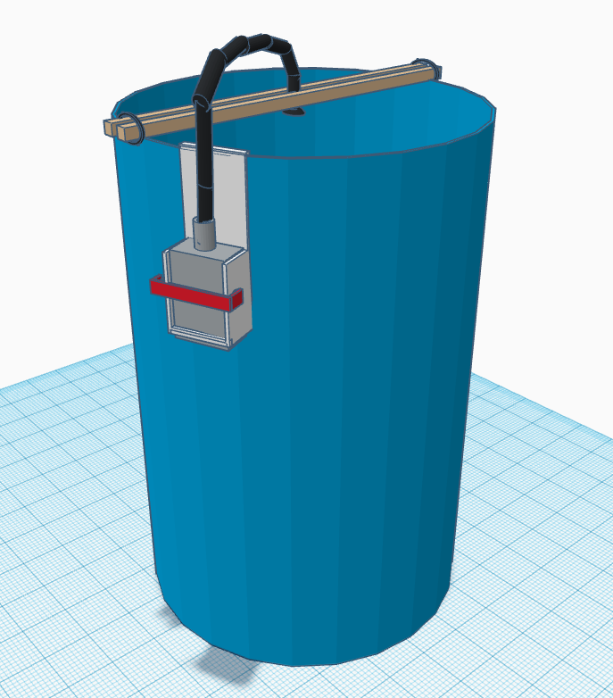
Water Subsystem - Design
The system was initially designed to use a float sensor to designate when the water was too low, however this was scrapped due to logistical reasoning. It was soon changed to an ultrasonic sensor that would sit at the top of the reservoir and determine water level via basic algebraic calculations.
A way to mount the subsystem after basic design was the next obstacle in the process in which a 3D model was made to allow the system to mount to the side of the reservoir.
A regulator was added to overcome the power obstacle in the finale of the initial design. Due to the natural decay of batteries, this was added to reliably keep power in the system.

Slide 18
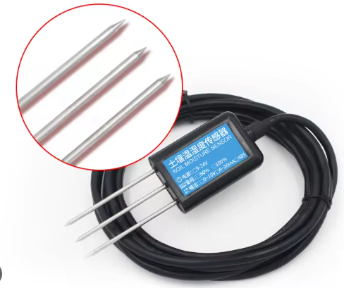
Nutrient Subsystem
Sensor Selection:
CWT-SOIL-NPKPHCTH-S: Selected for its multifunctionality, capable of measuring soil nutrient levels (NPK), pH, conductivity, temperature, and moisture content. It is primarily used for NPK and moisture level in this subsystem.
Communication Interface: Utilizes RS485 communication protocol for data transmission, enabling communication with the Arduino Nano 33 IoT board.
RS485 to TTL Conversion:
MAX485 Module: Integrated to facilitate communication between the RS485-enabled sensor and the Arduino Nano 33 IoT board via TTL (RX/TX) communication.
Functionality: Converts RS485 signals to TTL logic levels, ensuring compatibility with the Arduino Nano 33 IoT board's UART interface.
Data Acquisition Process:
RS485 Communication: Initializes communication between the sensor and the Arduino Nano 33 IoT board, allowing for data retrieval and sensor control commands.
Sensor Readings: Retrieves data on soil nutrient levels (NPK), pH, conductivity, temperature, and moisture content from the sensor via RS485 communication.
Serial Communication: Utilizes UART (Universal Asynchronous Receiver-Transmitter) communication between the Arduino Nano 33 IoT board and the MAX485 module for data exchange.

Slide 19
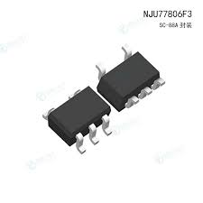
Nutrient Subsystem – Design
Design Description:
The nutrient monitoring subsystem was initially designed to measure nitrogen, phosphorus and potassium concentrations as well as moisture and pH in the soil then send that information to the PLC through an Arduino Nano 33 IoT via BLE connection.
As designing the system continued, a 6V voltage regulator was added between the Arduino and the battery pack to account for the system’s high current draw and allow for extended use of the system without the risk of falling below the minimum required voltage for the Arduino.
The nutrient system went through several design iterations with each iteration looking to improve upon the lifespan of the battery pack power supply. In its current state it was settled to use a Nisshinbo 6V dc-to-dc converter between the battery pack and the Arduino because it provided the lowest input voltage with the lowest amount of voltage fluctuation of all the converters that were suggested allowing us to utilize 86.7% of each battery’s total voltage reserves.

Slide 20
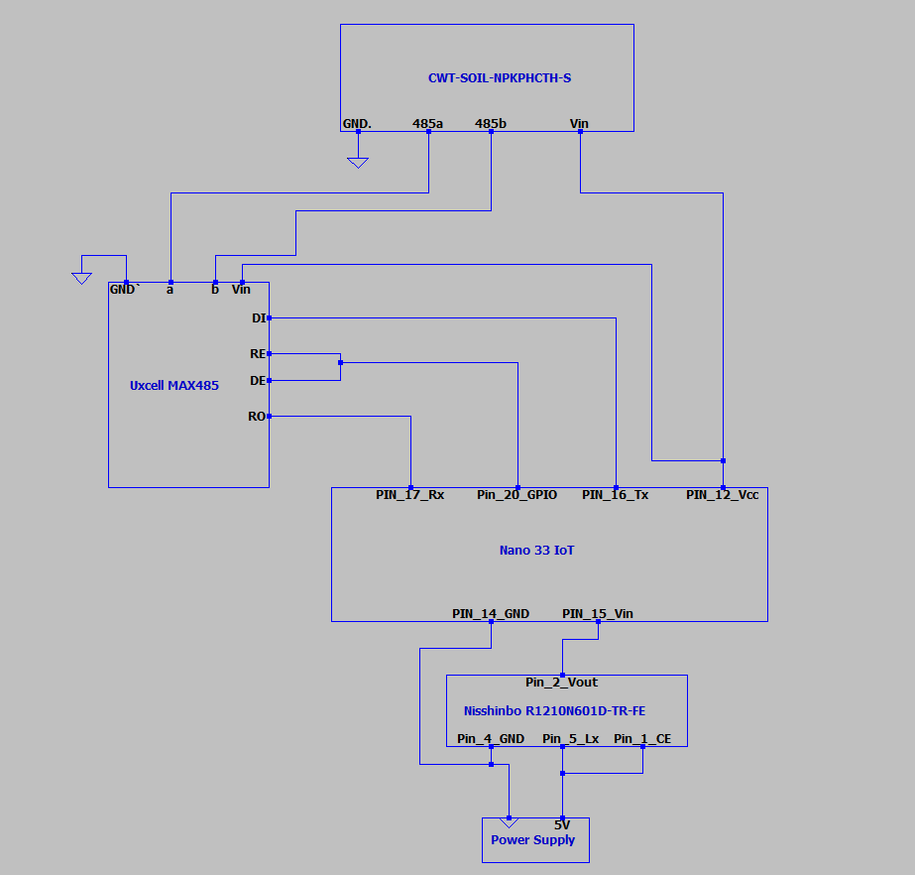
Nutrient Schematic
Schematic Details:
As seen in the schematic provided the cwt-soil-npkphcth-s communicates with the Arduino Nano 33 IoT via rs485 through a max485 translator connected to the Arduino’s Rx, Tx and GPIO pins that is powered via the Arduino’s 5V output pin.
Connected to the battery pack and the Arduino is a Nisshinbo DC to DC boost converter that is used to boost the input voltage from the battery pack as the battery voltage decreases over time to maintain a steady input voltage for the Arduino.
The Arduino requires a minimum input voltage of 5V which is provided by a battery pack power supply containing 4 1.5V batteries which are connected in series to provide a combined voltage of 6V. However, over time the batteries will slowly begin to lose their voltage as their capacities are drained leading to the pack quickly being unable to provide the minimum voltage for the Arduino.
To combat the problem stated above we have elected to add the DC-to-DC converter to provide a steady output of 6V ± 0.15V while taking an input voltages as low as 0.8V with the specific model we have chosen. To further combat this issue a sleep mode function has been added to the Arduino’s code to cycle the system in and out of low power (sleep) mode for 10 seconds every 5 minutes providing a duty cycle of 0.0333.

Slide 21
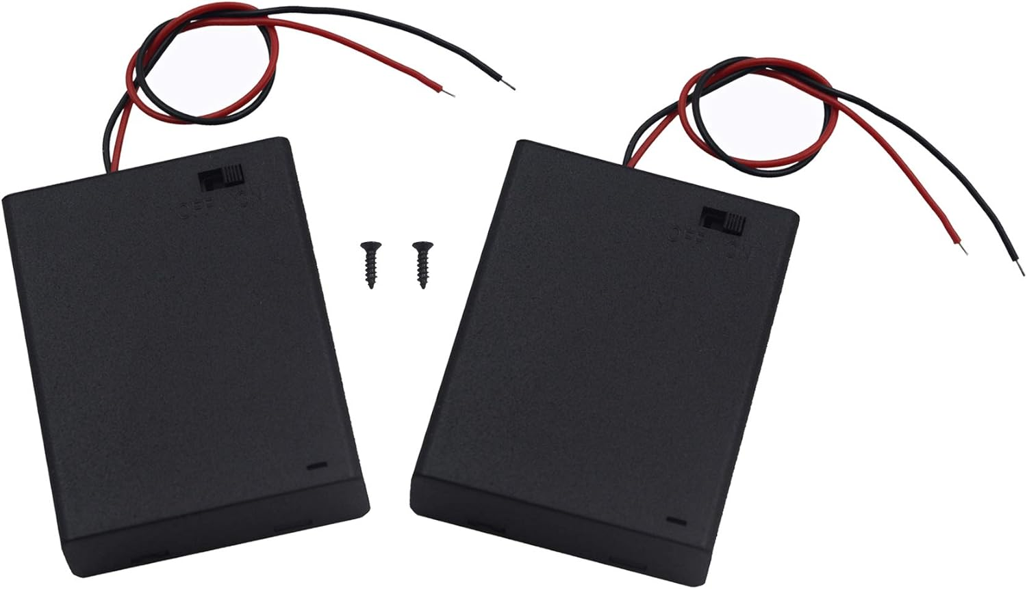
Nutrient Subsystem - Power
Since the converter has a minimum voltage rating of 0.8V we can calculate that each of the 4 batteries would need to supply at least 0.2V of voltage while in series to power the system meaning that approximately 87% of each battery’s total capacity is used while the system has a total current draw of 53.92mA while not in sleep mode and 10.39mA while in sleep mode.
When our duty cycle is applied to our current draw, we determine that the system will draw an average current of 11.841mA. While the battery pack will supply 2200mAH meaning that the system will theoretically last a total of 185.795 hours but with each of the batteries only using 87% of their total capacity we will realistically only be able to see 161.08 hours or 6.71 days of run time before the system falls below the minimum voltage requirements.

Slide 22

Nutrient Subsystem - Experimentation
Expected Results:
The system was expected to be able to read and send data for soil nitrogen, phosphorus and potassium concentrations as well as moisture and pH accurately.
The system was meant to have the sensor placed in an area of soil and to read the values listed above continuously for as long as the Arduino was not in sleep mode.
The system was then to send the data acquired through the Arduino to the PLC via BLE.
Finally, the system would enter sleep mode for a specified amount of time before beginning the cycle again.
Recorded Results:
During experimentation we found that the system can read in and send data for nitrogen and phosphorus reliably, if not entirely accurate, while it struggled to send potassium and moisture data with that data sending 56% and 16% of the time, respectively.
When it came to the soil’s pH, the system was unable to send or read the data at all. Instead, the system will read in the pH data as 255 consistently and will not change the value.
The unreliability of the system can be blamed upon addressing issues. The sensor that was chosen for the nutrient system provided no datasheet or documentation on what the addresses of the registers for each of the data values were. To make up for this lack of documentation, we used register values from a similar sensor, but they were not completely correct and resulted in the false readings and miscommunications between the sensor and the rest of the system.

Slide 23
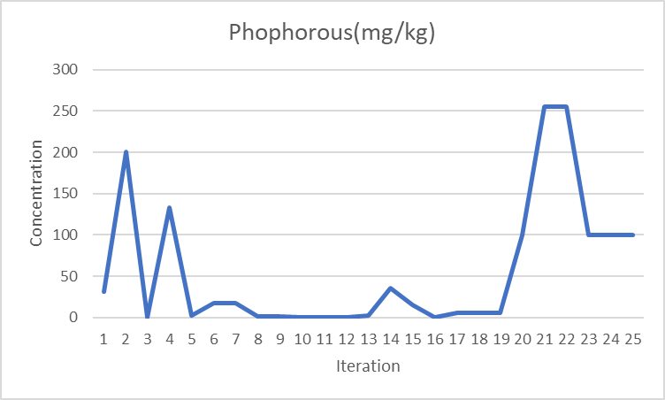
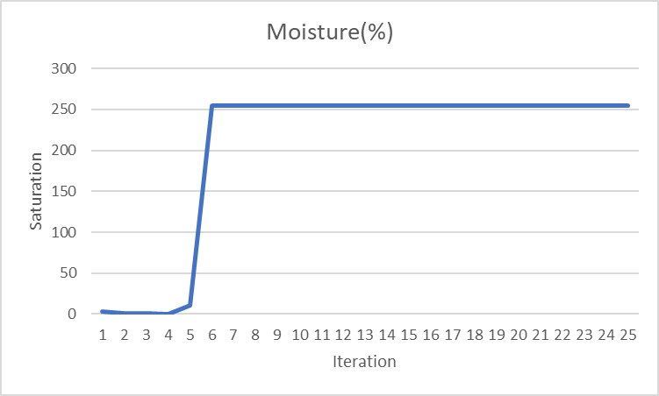
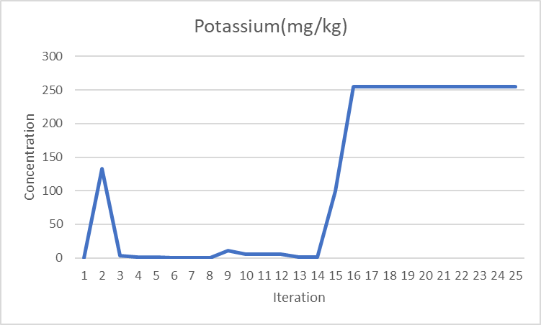
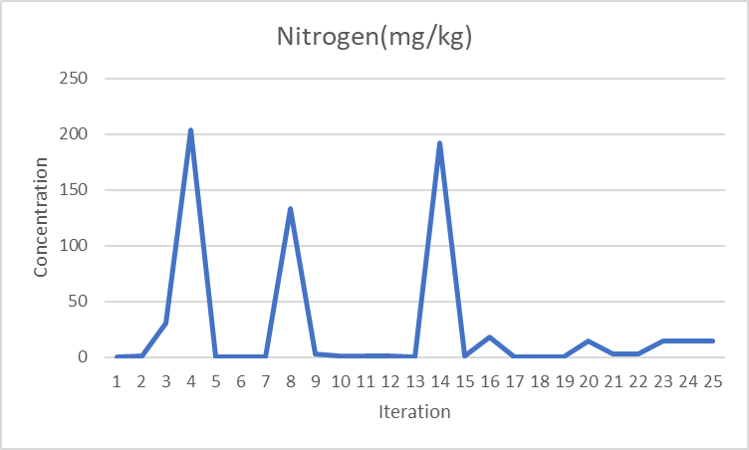
Nutrient Subsystem – Experimental Data
Data Explanation:
As seen in the graphs provided, nitrogen and phosphorus were able to be reliably measured and recorded modt of the time while potassium and moisture were much less reliable in their measurements.
The only measurement not shown here is the pH measurement. For that measurement, the sensor was never able to reliably send data to the rest of the system resulting in a graph much like the latter half of the moisture graph with all points having a value of 255.

Slide 24
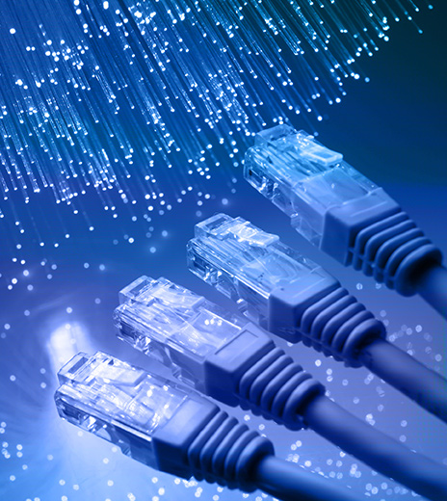
PLC and HMI Programming via Ethernet
Overview:
The PLC (Programmable Logic Controller) and HMI (Human-Machine Interface) are integral components of our autonomous greenhouse system.
They are interconnected via Ethernet using an Ethernet switch, facilitating communication between the two devices and the PC.
Configuration Process:
Assigned IP Addresses: We assigned unique IP addresses to both the PLC and HMI, allowing their distinct identities on the network.
Utilized PC's Private IP Address: Matched the first 8 digits of the IP addresses with the PC's private IP address.
Differentiation: Differed the last 2 digits of the IP address between the PLC and HMI.
Subnet Mask and Gateway: Configured the subnet mask and gateway settings to match on all three devices, enabling communication within the local network.
Achievements:
Seamless Communication: Enabled communication between the PLC, HMI, and PC, allowing data exchange and control functionalities.
HMI Display Integration: Programmed the PLC to communicate with the HMI, allowing real-time visualization of data and control parameters.

Slide 25
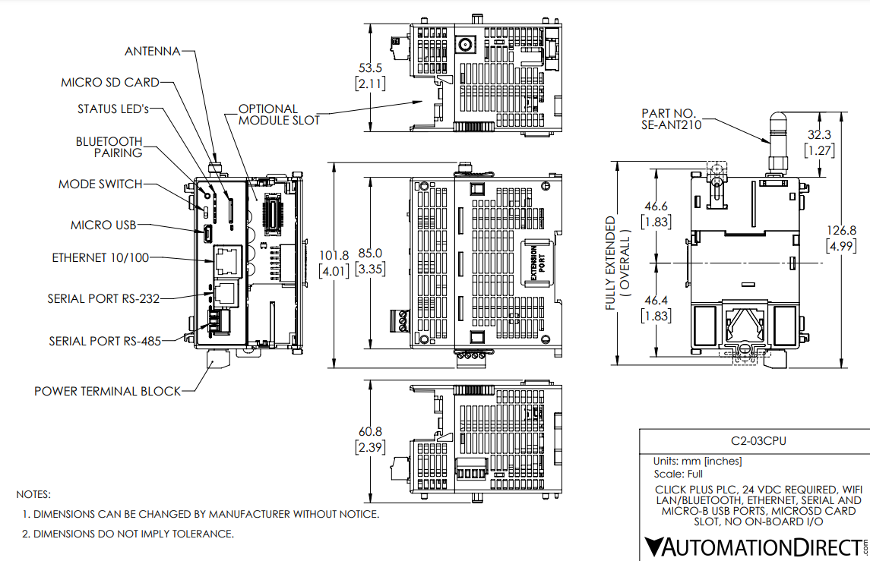
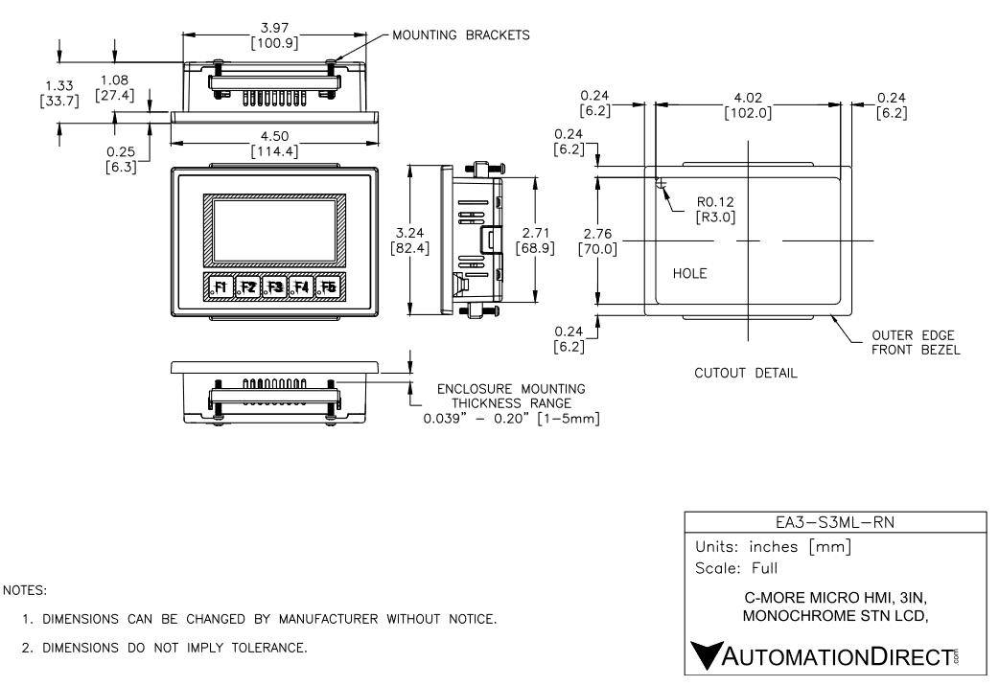
PLC & HMI - Design
PLC Design Explanation:
The PLC was initially designed to be able to connect to at least 3 external Arduino Nano 33 IoTs to receive data from the individual systems and to send commands to the systems all via BLE connection.
As design on the PLC progressed, we realized that the PLC itself was unable to send or receive data via BLE and therefore an additional Arduino was added to the PLC system itself to send and receive via BLE.
HMI Design Explanation:
The HMI was initially designed to receive data from the PLC and display said data via the HMI’s screen and menus. The HMI was also designed to allow users to change between menus and issue commands to the systems through the PLC via the HMI’s 5 function buttons located at the bottom of the HMI casing.

Slide 26
PLC & HMI - Experimentation
The PLC was able to send to the EA3-S3ML HMI. After many attempts, through matching IP addresses and subnets, we managed to allow the EA3-S3ML to display values connected the HMI by address in real time.
We could not get the ladder logic to take in the ASCII sent from the arduino even when using the given functions for doing said protocol. The PLC would display that is receiving via RS-232, but we could not get the value to stick to an address in the PLC.
The HMI was coded to move between screens which would each display different values that would be held for each subsystem. The 1 second clock was used to prove connection via HMI and PLC that displayed in real time.

Slide 27
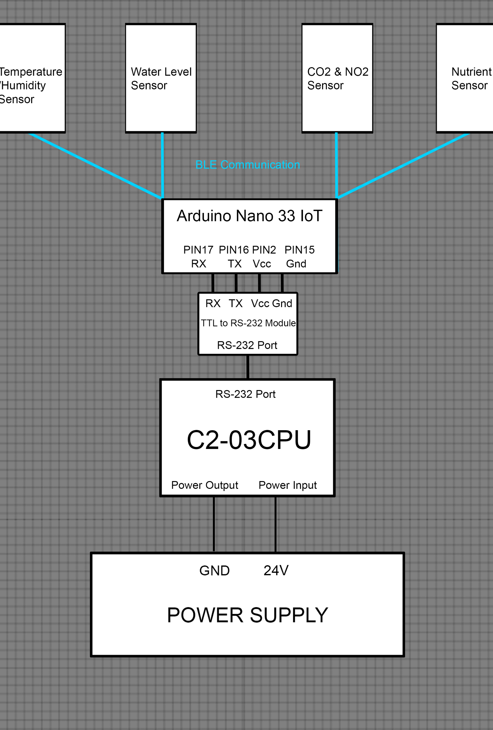
PLC Schematic
PLC Description:
As seen to the left, the PLC is connected to a 24V power supply and then connected to an Arduino Nano 33 IoT via a rs232 to TTL translator which is then further connected to the Arduino’s of each of the subsystems via a BLE connection.
The PLC is connected to the Arduino Nano 33 IoT to be able to send commands and receive data from the other subsystems wirelessly as the PLC itself does not support BLE connection.

Slide 28
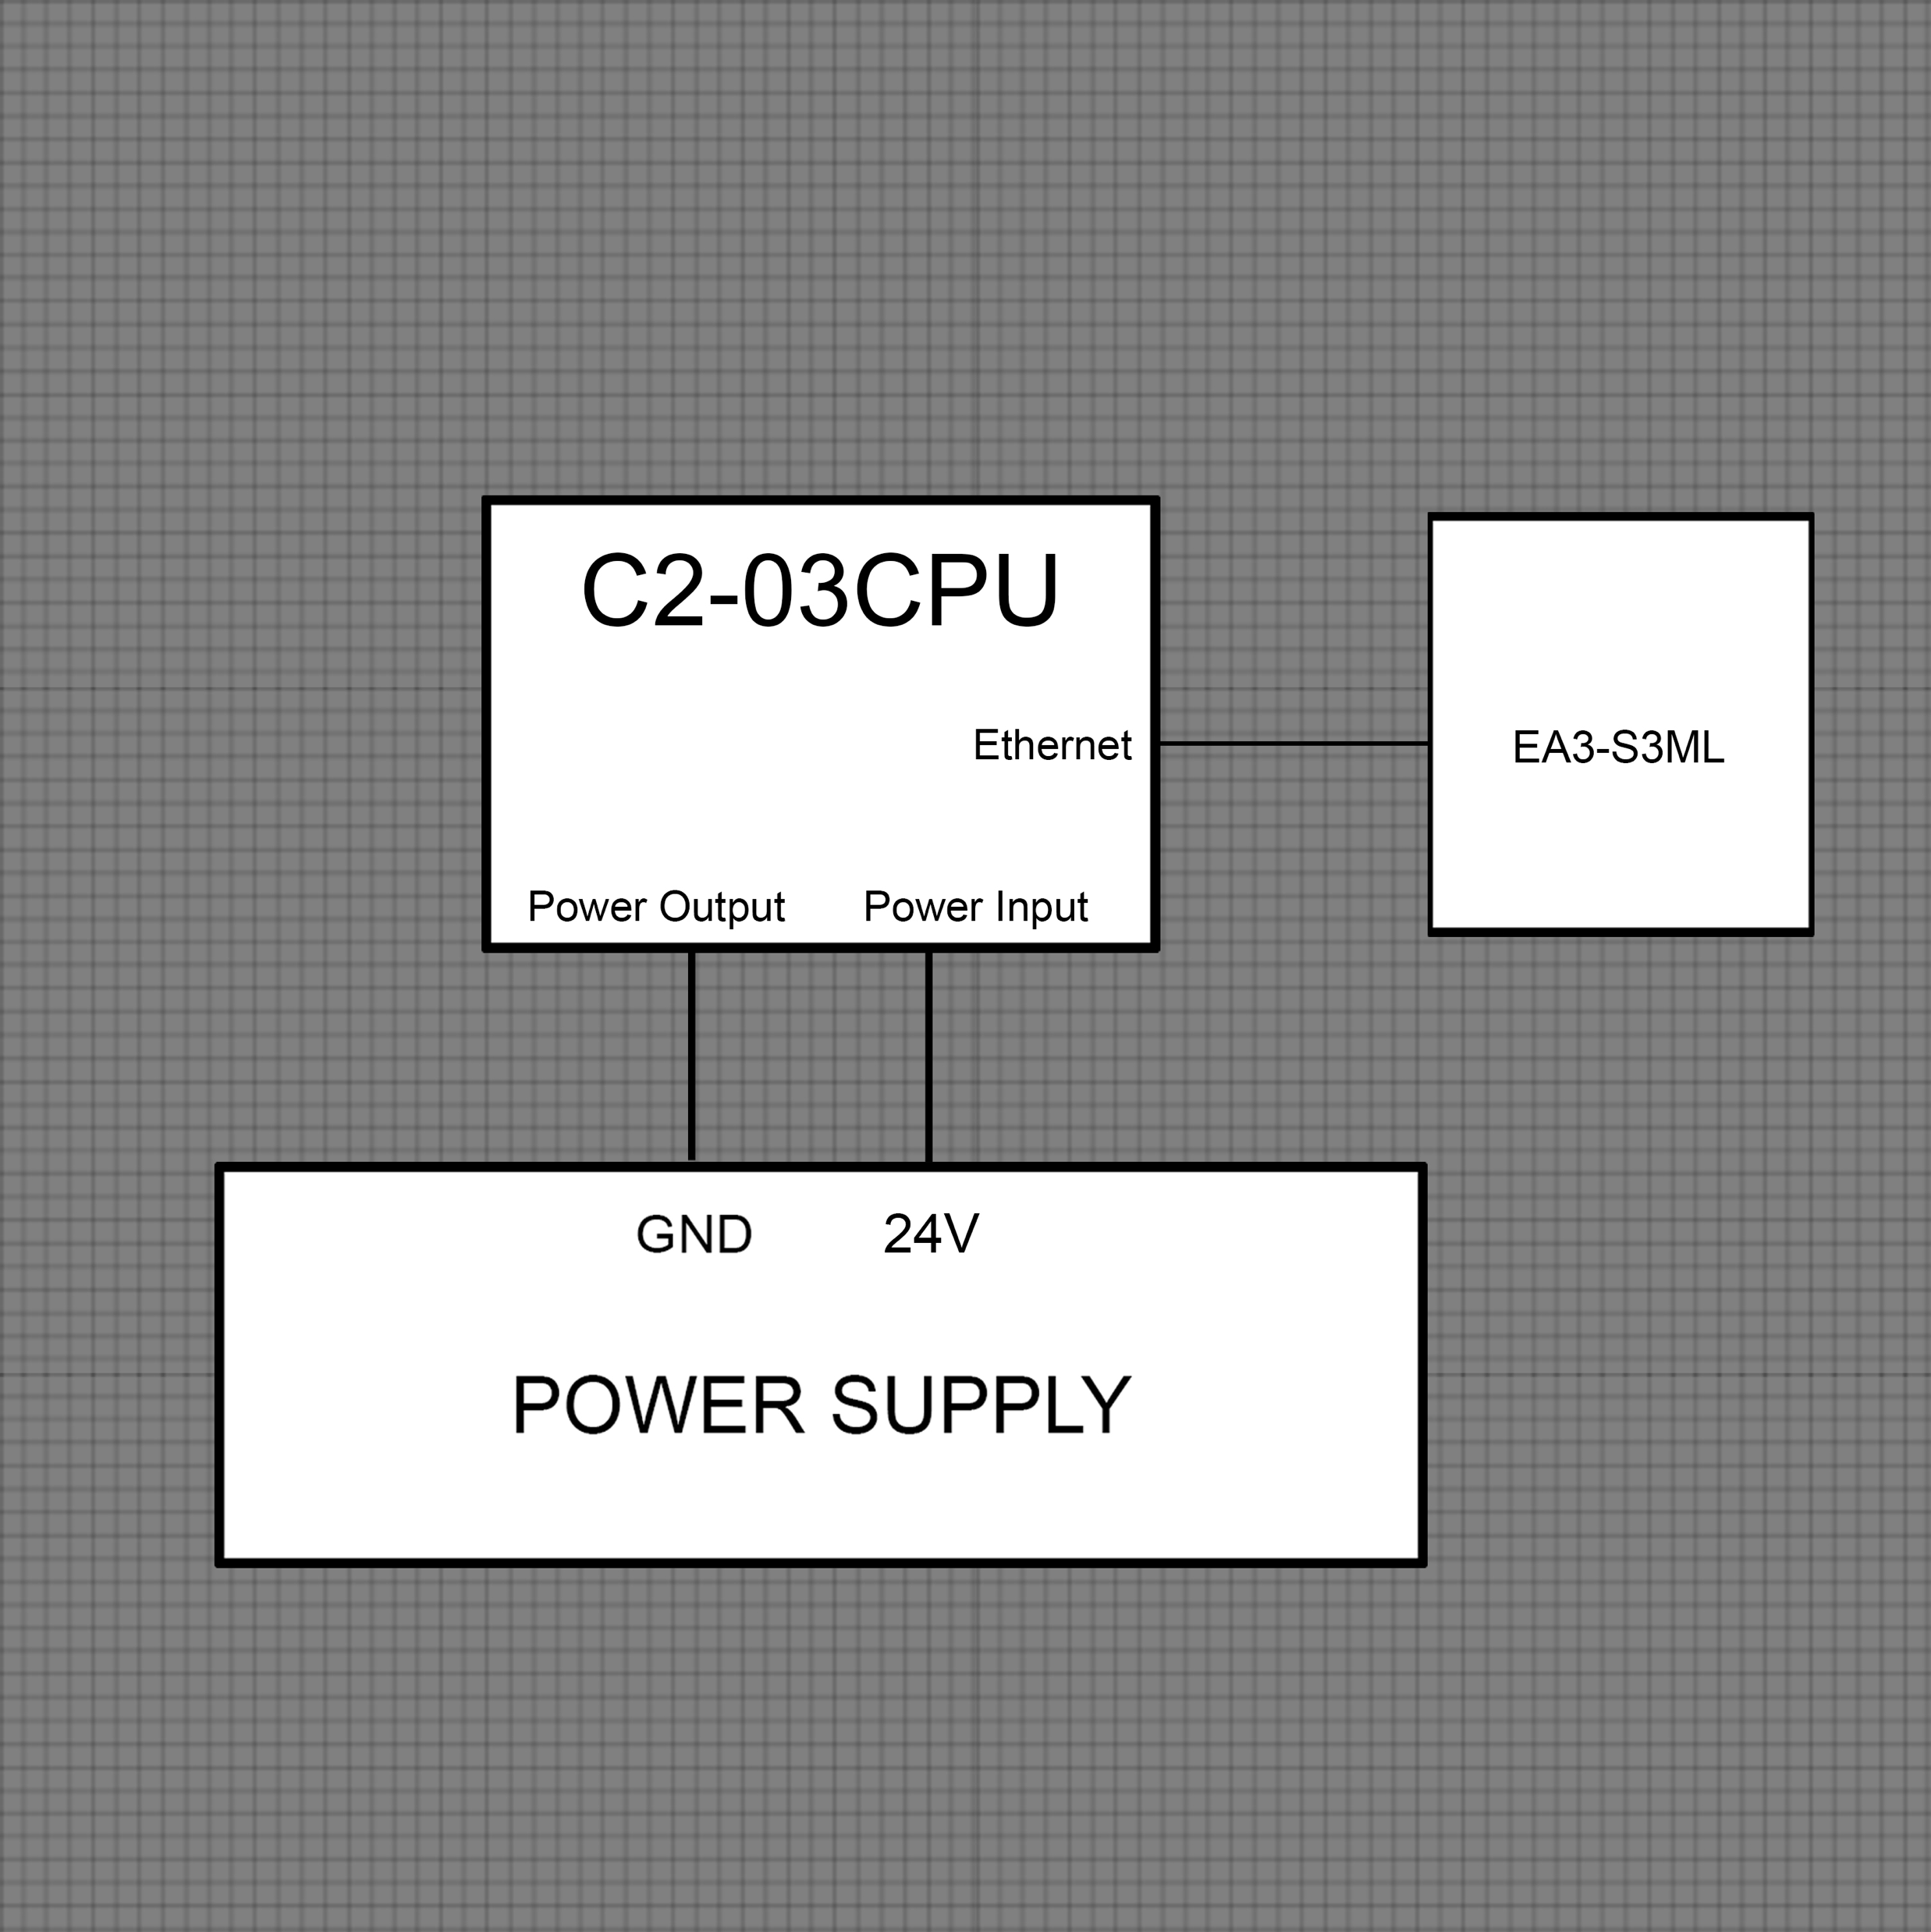
HMI Schematic
HMI Description:
As seen in the schematic to the left, the HMI is connected to the PLC via the PLC’s ethernet port.
The PLC will transfer information that is required to be displayed to the HMI via the ethernet port.
The information is then displayed on the various menus of the HMI as requested by the user via the HMI’s function buttons.

Slide 29
Budget
Subsystem | Projected Cost | Actual Cost
CO₂ & NO₂ | $101.80 | $139.72
Temperature | $70.36 | $51.58
Lighting | N/A | $284.95
Water Level | $153.11 | $96.10
Nutrient | $392.53 | $132.55
PLC & HMI | $700.35 | $692.95
Total | $1,418.15 | $1,397.85
At the start of the project our team had projected a total budget of $1,418.15 during the project proposal, however, after all ordering for the project was completed, our final budget was $1,397.85 indicating that we were 1.43% under our targeted budget.
Our resulting final budget will allow future capstone teams to expand upon our current results and will also allow the Tennessee Tech Agricultural Department to expand this project to other greenhouses.

Slide 30



Acknowledgements
Our team would like to acknowledge and extend a special thank you to our sponsor, EOSYS, the Tennessee Tech mechanical engineering and agricultural departments, Mr. Jesse Roberts, Dr. Jeffery Austen, Mr. Conrad Murray, Mr. James Baier and our advisor, Mr. Jeremy Bastoky, from EOSYS.

